Slide 1
Unit 8
Part b

Slide 2
Applet
An applet is a Java program that can be embedded into a web page. It runs inside the web browser and works at client side. An applet is embedded in an HTML page using the APPLET tag and hosted on a web server.
Applets are used to make the web site more dynamic and entertaining.

Slide 3
Applet
All applets are sub-classes (either directly or indirectly) of java.applet.Applet class.
Applets are not stand-alone programs. Instead, they run within either a web browser or an applet viewer. JDK provides a standard applet viewer tool called applet viewer.
In general, execution of an applet does not begin at main() method.
Output of an applet window is not performed by System.out.println(). Rather it is handled with various AWT methods, such as drawString().

Slide 4
Applet
Advantage of Applet
It works at client side so less response time.
Secured
It can be executed by browsers running under many platforms, including Linux, Windows, Mac Os etc.
Drawback of Applet
Plugin is required at client browser to execute applet.

Slide 5
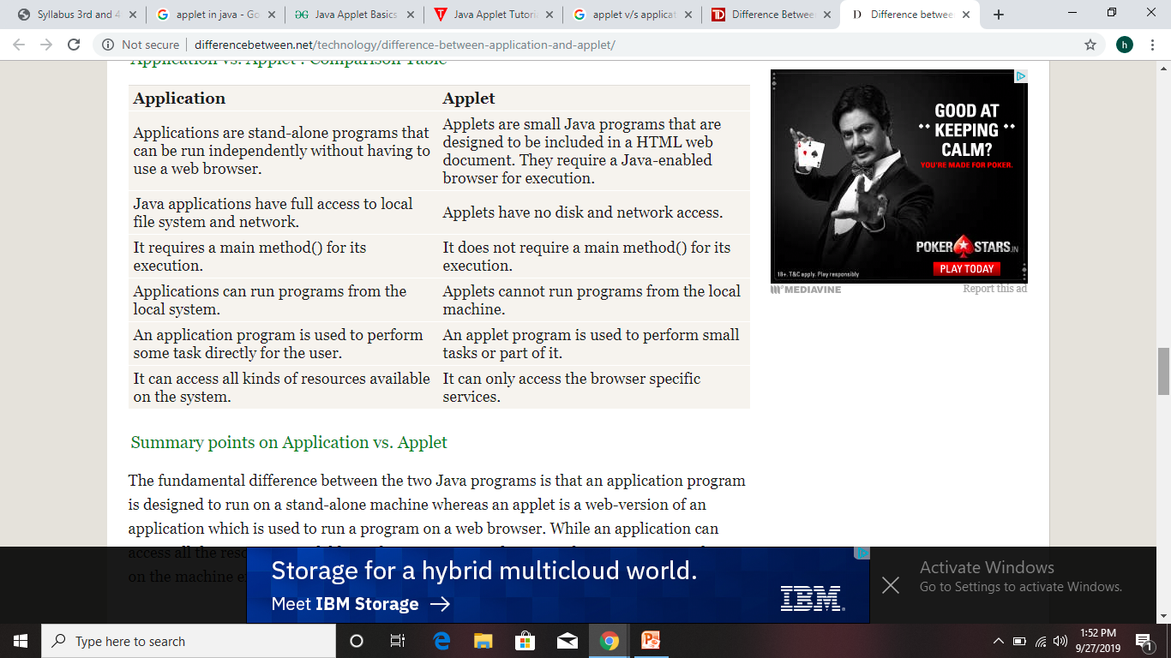
Application program v/s Applet

Slide 6
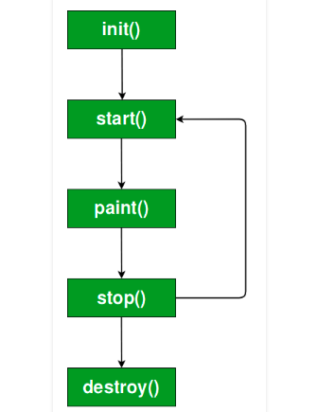
Applet life cycle

Slide 7
Applet life cycle
init( ) : The init( ) method is the first method to be called. This is where you should initialize variables. This method is called only once during the run time of your applet.
start( ) : The start( ) method is called after init( ). It is also called to restart an applet after it has been stopped. Note that init( ) is called once i.e. when the first time an applet is loaded whereas start( ) is called each time an applet’s HTML document is displayed onscreen. So, if a user leaves a web page and comes back, the applet resumes execution at start( ).

Slide 8
Applet life cycle
paint( ) : The paint( ) method is called each time an AWT-based applet’s output must be redrawn. This situation can occur for several reasons. For example, the window in which the applet is running may be overwritten by another window and then uncovered. Or the applet window may be minimized and then restored.paint( ) is also called when the applet begins execution. Whatever the cause, whenever the applet must redraw its output, paint( ) is called.
The paint( ) method has one parameter of type Graphics. This parameter will contain the graphics context, which describes the graphics environment in which the applet is running. This context is used whenever output to the applet is required.

Slide 9
Applet life cycle
stop − This method is automatically called when the user moves off the page on which the applet sits. It can, therefore, be called repeatedly in the same applet.
destroy − This method is only called when the browser shuts down normally. Because applets are meant to live on an HTML page, you should not normally leave resources behind after a user leaves the page that contains the applet.

Slide 10
Creating an executable applet
First a java file is created with applet code.
Then a HTML file is created in which we want to embed our applet.

Slide 11
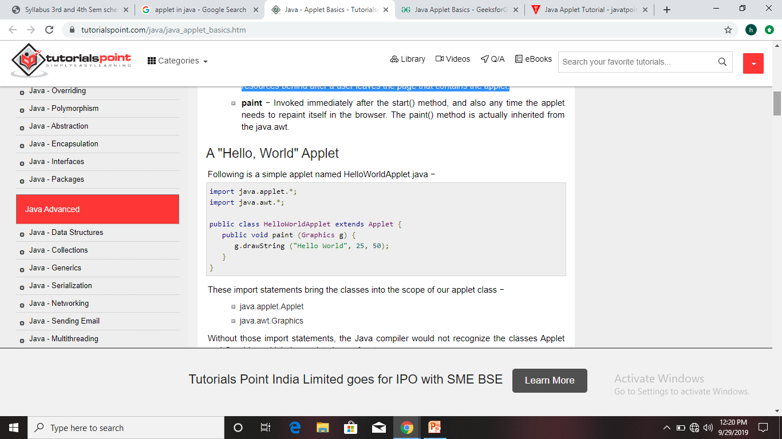
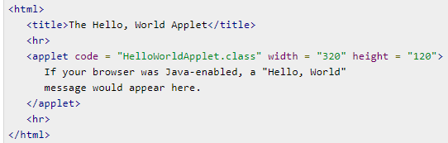
Creating applet

Slide 12
Creating applet
The above java program begins with two import statements. The first import statement imports the Applet class from applet package. Every AWT-based(Abstract Window Toolkit) applet that you create must be a subclass (either directly or indirectly) of Applet class. The second statement import the Graphics class from AWT package.
The next line in the program declares the class HelloWorld. This class must be declared as public because it will be accessed by code that is outside the program. Inside HelloWorld, paint( ) is declared. This method is defined by the AWT and must be overridden by the applet.
Inside paint( ) is a call to drawString( ), which is a member of the Graphics class. This method outputs a string beginning at the specified X,Y location. It has the following general form:void drawString(String message, int x, int y) Here, message is the string to be output beginning at x,y. In a Java window, the upper-left corner is location 0,0. The call to drawString( ) in the applet causes the message “Hello World” to be displayed beginning at location 20,20.

Slide 13
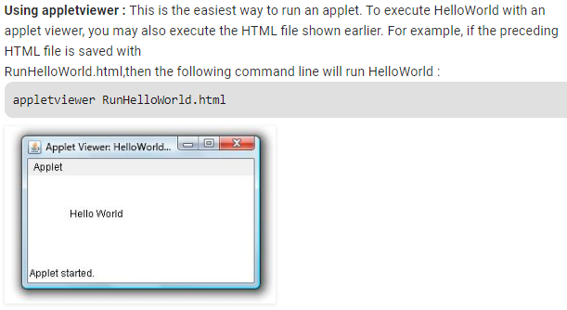
Output

